Slide 1
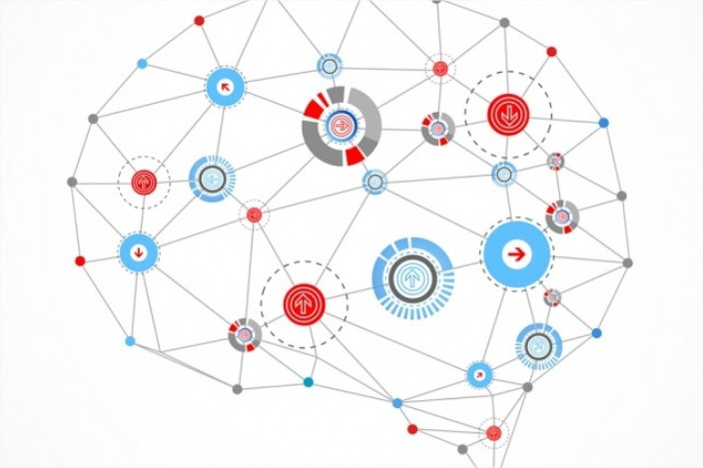

AUTOENCODERS

Slide 2
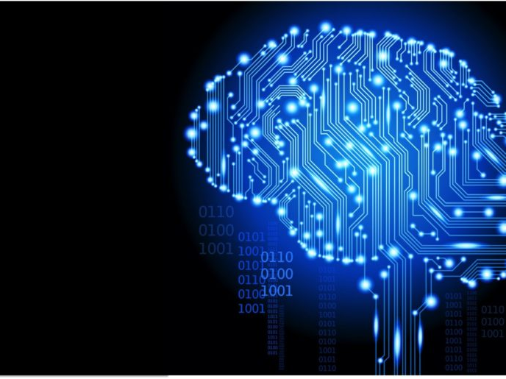
Summary
• Autoencoding
• Properties of autoencoders
• Fundamental theory
• Pros & Cons
• Application areas
• Example : MNIST handwritten digit dataset

Slide 3
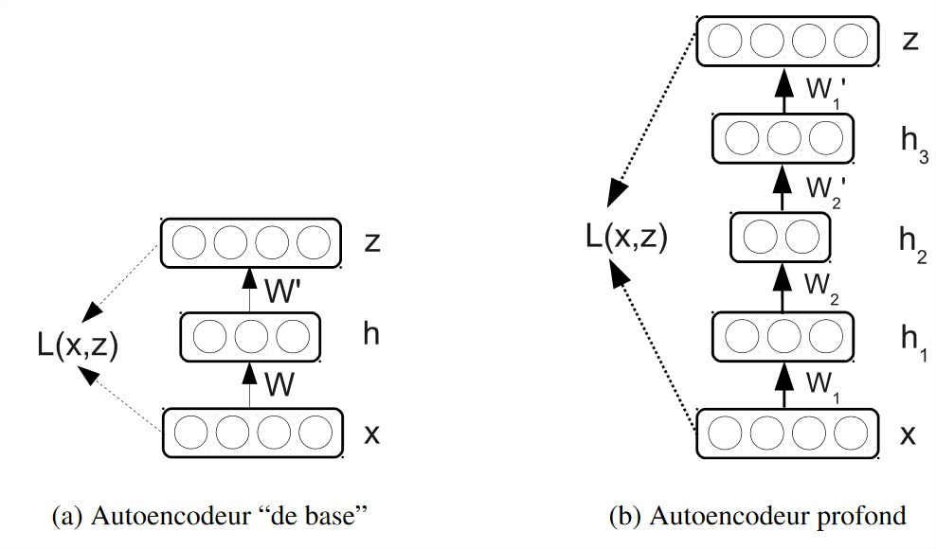
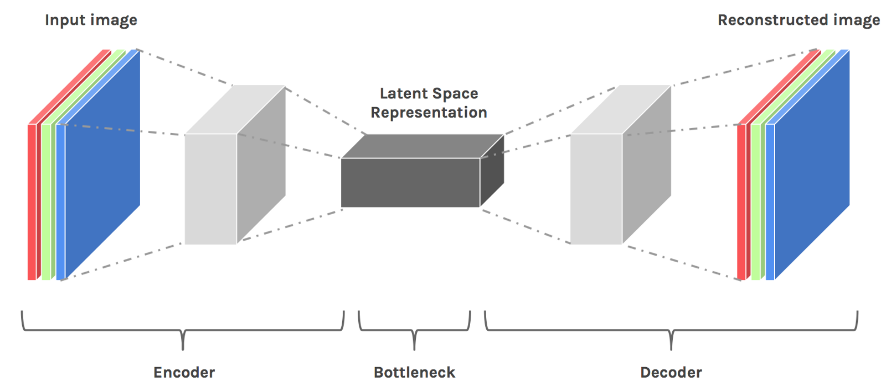
Autoencoding
• Compression / Decompression algorithm applies on data
• Autoencoders learn a “compressed representation” of input
Basic Autoencoder
1 hidden layer
Deep Autoencoder
Several hidden layers
Operating principle of autoencoders

Slide 4
Properties of autoencoders
• Data specific : Able to compress data similar to what they have been trained on
• Lossy : Decompressed outputs will be degraded compared to the original inputs (each input image has features that
can normally be described as single, discrete values)
• Learned automatically from data examples rather than engineerded by a human : Non supervised / auto supervised
(no labeled data)
• To build an autoencoder you need : - an encoding function
- a decoding function
- a distance function between the amount of information loss between compressed/decompressed representation of your data (= « loss » function)
• Number of inputs = Number of outputs, « tunnel shape» for the neural network

Slide 5
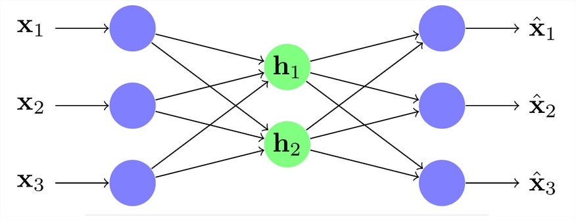
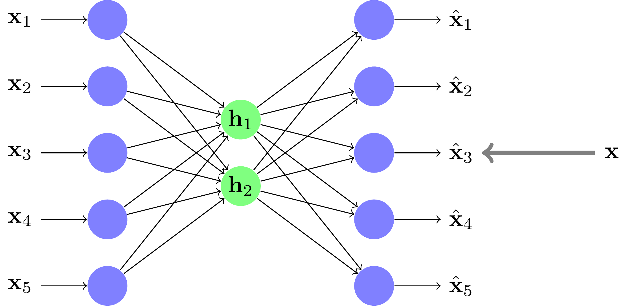
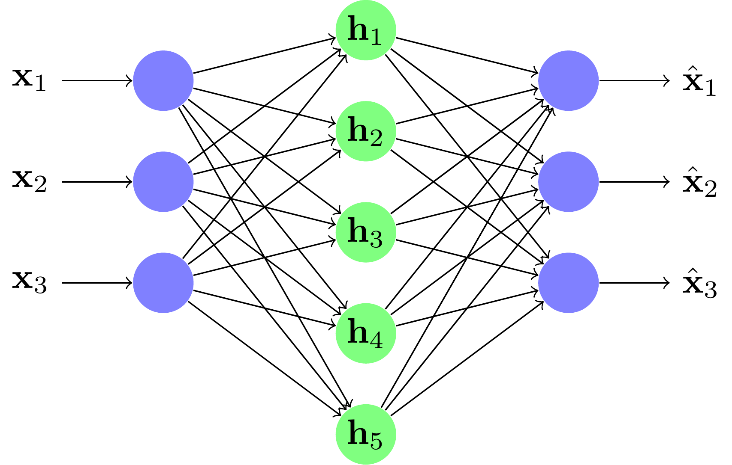
Under complete
Over complete

Slide 6
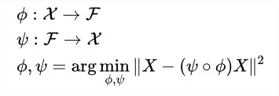
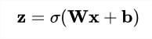
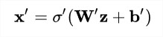
Fundamental theory
Encoder
Decoder
Auto-encoder
z → Latent variables or latent representation.
σ → Nonlinear activation function (sigmoïde, ReLU)
W → Weight matrix
b → Bias vector
Encoding
Decoding
With :
Loss / Reconstruction error

Slide 7
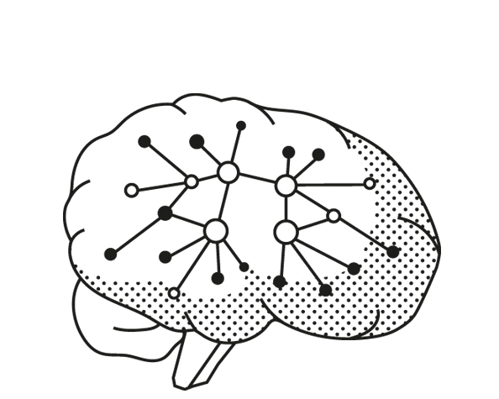
Pros & Cons
• Main advantages : - Training deep networks from scratch
- Storage gain : possibility to reconstruct the input from the smaller representation
- An autoencoder doesn’t have to learn dense layers, it can use convolutional layers to learn too
• Main issues : - Not good as basic algorithm at data compression ( Especially in picture compression)
- Not practical for real world data compression problems ( you can only use them on data that is similar to what they were trained on)

Slide 8
Application areas
• Dimensionality Reduction : improve performance → Models of smaller spaces consume less memory and runtime.
Due to non-linear nature, autoencoders tend to perform better than traditional techniques like PCA etc. (data visualization)
• Denoising and Transformation : Distort data and add some noise in it. (image transformation, document cleaning, applying color to images, medical image segmentation, filtering)
• In Natural Language Processing : Word Embeddings, Machine Translation, Document Clustering, Sentiment Analysis, Paraphrase Detection
• Image/data Generation, Anomaly detection : Credit card fraud detection, defects in manufacturing etc.

Slide 9
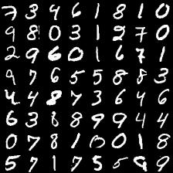
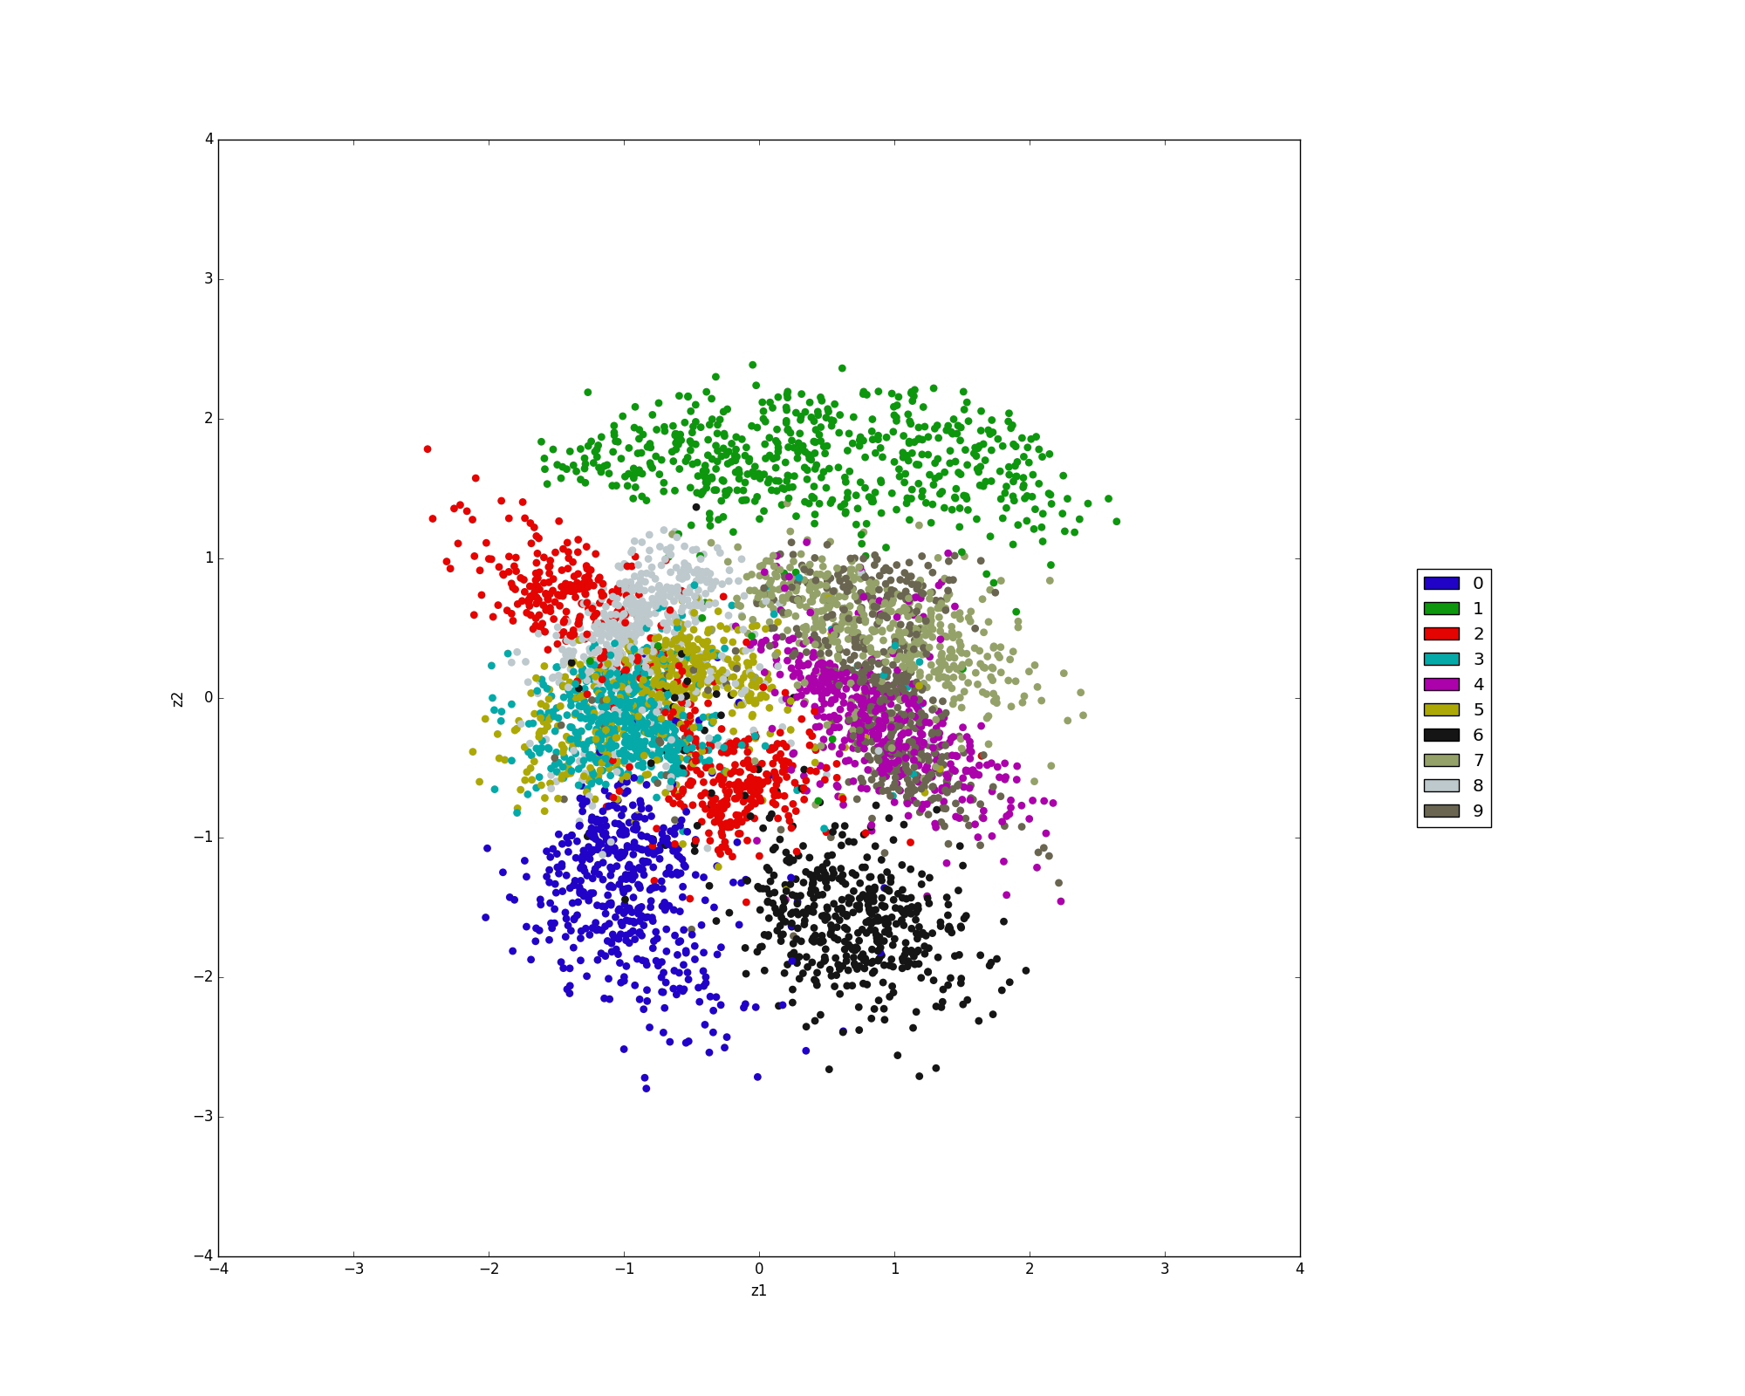
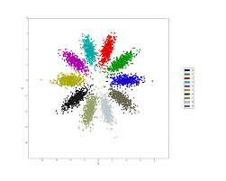
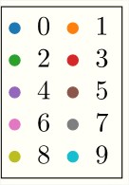
Example : MNIST handwritten digit dataset
Visualization of the latent space :
→ quickly separates into clusters for each different digit
MNIST Dataset
Epoch 3
Epoch 265

Slide 10
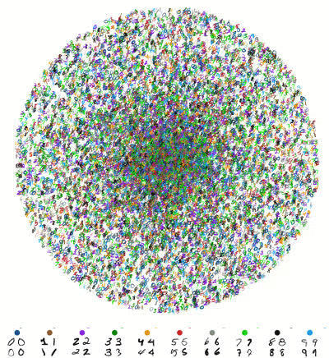
QUESTIONS ?

